Slide 1
Web Programming with Servlets & JSP
ASSIGNMENT GUIDELINE

Slide 2
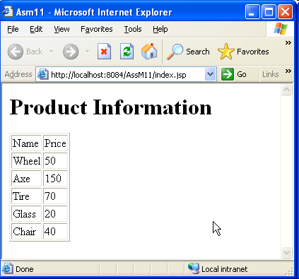
Assignment Guideline 11_1
Creating the JSP page using
  Declaring the String array with form of each elements as productName:price
  Using c:forEach, c:forTokens, and c:out to traverse and print each element of array as above image

Slide 3
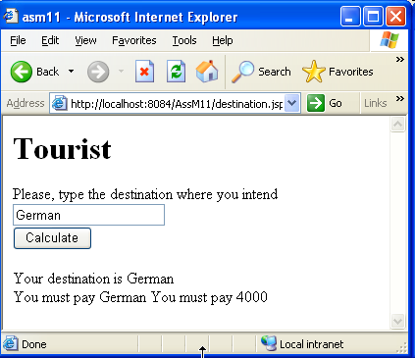

Assignment Guideline 11_2
Creating the JSP page using
  Declaring the String array with form of each elements as destinationName:price
  Building the form with a textbox and a button
  Using c:forEach, c:forTokens, c:if, c:set, and c:out to traverse, checking the existing destination and print as above image

